Slide 1
Trade Liberalization and Labor-Market Outcomes: Evidence from US Matched Employer-Employee Data
Justin R. Pierce Board of Governors, U.S. Federal Reserve
Peter K. Schott Yale School of Management & NBER & CEPR
Cristina Tello-Trillo U.S. Census Bureau May 2023

Slide 2
Disclaimer
The views expressed in the paper are those of the authors and not necessarily those of the U.S. Census Bureau. The Census Bureau's Disclosure Review Board and Disclosure Avoidance Officers have reviewed this data product for unauthorized disclosure of confidential information and have approved the disclosure avoidance practices applied to this release. DRB Approval Numbers CBDRB-FY21-CES006-002, CBDRB-FY21-327 and CBDRB-FY22-CES020-001.

Slide 3
Motivation
Many papers in labor and trade examine impact of labor-market shocks
Substantial attention has been devoted to the “China shock”, yet important questions remain unanswered
What drives heterogeneous responses among workers?
Why no pro-competitive effects?
We re-visit US granting of PNTR to China using employer-employee data
Questions we address:
Impact of county versus industry exposure?
Outcomes inside versus outside manufacturing?
Benefits of upstream exposure?
Effect of high- versus low-tenure?
Impact of other worker and firm attributes (awaiting disclosure)?
Where did displaced manufacturing workers go?
Notes:
11-12:15pm
Hakobyan and Mclaren look at NAFTA: they find the lowest educated are hurt
Autor et al look at Chinese import penetration over a long difference, 1992-07; they look only at the direct effect on workers long-term earnings an employment
Dix Carneiro and Kovak (2017) e “regional tariff reduction” look at workers exposure to tariff declines based on their regions’ exposure to these declines.
following the Brazilian trade liberalization of the early 1990s. Using 25 years of data they find large and growing effects of trade liberalization on regional formal
earnings and employment, main reason lack of labor mobility.
Devlin kovak morrow: This paper uses matched longitudinal administrative data for Canadian workers during 1984-2004 to assess the long-run effects of the 1988 Canada-U.S. Free Trade Agreement (CUSFTA) onthe Canadian labor market. No cumulative long-terms effects, increase export expansion accompanied by import competition, in the short term they do see increase in separations (out of the labor force) long term no big effects, earnings fo back to normal.
For workers initially in man-ufacturing industries that experienced Canadian concessions, we find a heightened probability ofwork-shortage based separations at large firms but little impact on long-run cumuilative earnings.Lower cumulative earnings at the initial employer are offset by gains outside manufacturing. ForCanadian workers in industries that obtained U.S. concessions, we find a lower probability of sep-aration and higher cumulative earnings. These effects are concentrated among workers initiallyemployed in larger firms, and there are important differences between low and high attachmentworkers.
All of these papers are a bit different: We look at a specific trade liberalization like T, HM, DCK but look at China’s impact on US like Autor. Unlike Autor but like HM we look at the impact at different levels or education. Unlike Autor, we look specific trade liberalization.
so, why does this matter?
Isn’t what we find obvious?
Are we trying to recover frictions?
This paper extends the literature on labor market impacts of trade by shifting the focus from aggregate market level reactions to adjustments at the worker level. We will be able to quantify the distribution of incidence among workers along two margins, industry and county margin. ADHS (2014) are able to measure worker-level consequences by focusing on the substantial differences in trade exposure that derive from the initial industry of employment (but not location). We are able to decompose the magnitude of both, the initial industry of employment and also the location of employment. Our 5% extract of the LEHD (for large counties) and 100% extract for small counties provides a more precise measurement of local industry composition.
AHD (2013) is aout changes in employments and average earnings across U.S. local labor markets (CZ) resulting from regiona exposure from import competition from China. That work used repeated cross sections (CBP) on geographic localities it cannot address how individuals adjust to trade schoks.

Slide 4
Key Findings/Contributions
Exposed M workers exhibit substantial losses in relative earnings
County exposure matters more than industry exposure
Upstream exposure mitigates own and downstream exposure
For NM workers, gains from upstream exposure can offset losses from own and downstream exposure

Slide 5
Related Literatures An incomplete list!
Mass layoffs: Jacobson et al. (1993), Von Wachter and Davis (2011), Hummels et al. (2014), etc.
Spatial and labor market frictions: Topel (1986), Blanchard and Katz (1992), Glaeser and Gyourko (2005), etc., Traiberman (2019), Caliendo et al. (2019), Dauth et al (2017), etc.
Import shocks: Topolova (2007), Kovak (2013), Hakobyan and Mclaren (2016), Dix-Carneiro and Kovak (2017), Kovak and Morrow (2020), etc.
China shock: Ebenstein et al. (2011), Autor et al. (2013, 2014), Pierce and Schott (2016), Acemoglu et al. (2016), Bloom et al. (2019); Hurst et al (2019), etc.

Slide 6
Existing China Shock Evidence is Mixed
Manufacturing
Non-Manufacturing
i region^{own} (ADH 2013)
0 region^{own} (ADH 2013)
Employment
i region^{own} (BHKL 2019)
h high-skill region^{own} (BHKL 2016)
i region^{own} region^{down} (AADHP 2016)
i region^{own} region^{down} (AADHP 2016)
i industry^{own} industry^{down} (AADHP 2016)
i industry^{own} industry^{down} (AADHP 2016)
i industry^{own} industry^{down} (PS 2016)
0 region^{own} (ADH 2013)
i region^{own} (ADH 2013)
Wages
i low-skill region^{own} (BHKL 2016)
i low-skill region^{own} (BHKL 2016)
h high-skill region^{own} (BHKL 2016)
h high-skill region^{own} (BHKL 2016)
i region^{own} industry^{own} (ADHS 2014)

Slide 7
Existing China Shock Evidence is Mixed
Manufacturing
Non-Manufacturing
Employment
Wages

Slide 8
Existing China Shock Evidence is Mixed
Manufacturing
Non-Manufacturing
i region^{own} (ADH 2013)
Employment
i region^{own} (BHKL 2019)
i region^{own} region^{down} (AADHP 2016)
i industry^{own} industry^{down} (AADHP 2016)
i industry^{own} industry^{down} (PS 2016)
M employment declines found in all studies
Wages

Slide 9
Existing China Shock Evidence is Mixed
Manufacturing
Non-Manufacturing
i region^{own} (ADH 2013)
0 region^{own} (ADH 2013)
Employment
i region^{own} (BHKL 2019)
h high-skill region^{own} (BHKL 2016)
i region^{own} region^{down} (AADHP 2016)
i region^{own} region^{down} (AADHP 2016)
i industry^{own} industry^{down} (AADHP 2016)
i industry^{own} industry^{down} (AADHP 2016)
i industry^{own} industry^{down} (PS 2016)
M employment declines found in all studies
NM employment results are mixed
Wages

Slide 10
Existing China Shock Evidence is Mixed
Manufacturing
Non-Manufacturing
i region^{own} (ADH 2013)
0 region^{own} (ADH 2013)
Employment
i region^{own} (BHKL 2019)
h high-skill region^{own} (BHKL 2016)
i region^{own} region^{down} (AADHP 2016)
i region^{own} region^{down} (AADHP 2016)
i industry^{own} industry^{down} (AADHP 2016)
i industry^{own} industry^{down} (AADHP 2016)
i industry^{own} industry^{down} (PS 2016)
M employment declines found in all studies
NM employment results are mixed
0 region^{own} (ADH 2013)
i region^{own} (ADH 2013)
Wages
i low-skill region^{own} (BHKL 2016)
i low-skill region^{own} (BHKL 2016)
h high-skill region^{own} (BHKL 2016)
h high-skill region^{own} (BHKL 2016)
i region^{own} industry^{own} (ADHS 2014)
Wage results are mixed

Slide 11
Existing China Shock Evidence is Mixed
Manufacturing
Non-Manufacturing
i region^{own} (ADH 2013)
0 region^{own} (ADH 2013)
Employment
i region^{own} (BHKL 2019)
h high-skill region^{own} (BHKL 2016)
i region^{own} region^{down} (AADHP 2016)
i region^{own} region^{down} (AADHP 2016)
i industry^{own} industry^{down} (AADHP 2016)
i industry^{own} industry^{down} (AADHP 2016)
i industry^{own} industry^{down} (PS 2016)
M employment declines found in all studies
NM employment results are mixed
0 region^{own} (ADH 2013)
i region^{own} (ADH 2013)
Wages
i low-skill region^{own} (BHKL 2016)
i low-skill region^{own} (BHKL 2016)
h high-skill region^{own} (BHKL 2016)
h high-skill region^{own} (BHKL 2016)
i region^{own} industry^{own} (ADHS 2014)
Wage results are mixed
Bloom et al. focus on regional skill abundance
We focus on the pro-competitive effect of upstream exposure

Slide 12
Outline
Introduction
Data
Reallocation after PNTR
PNTR and earnings: direct specification
PNTR and earnings: IO specification
Conclusion

Slide 13
Data
LEHD: Longitudinal Employer-Household Dynamics Database
Based on state UI records, 1993-2014
State availability depends on time period
Quarterly earnings (gross salaries+bonuses+tips) and employment
Worker demographics: gender, age, race, ethnicity, education
Workers matched to establishments
LBD: Longitudinal Business Database
Establishments matched to NAICS codes and firms
Establishment and firm characteristics (e.g., size, diversification)
LFTTD: Longitudinal foreign trade transactions database
Firms matched to import and export transactions
Notes:
CA, FL, PA are there…

Slide 14
LEHD Samples
The number of states available in the LEHD increases over time
We make use of two extracts
2000-2007: 46-states: examine overall MnNM reallocation
1993-2014: 19-state sample: DID regressions

Slide 15
Outline
Introduction
Data
Reallocation after PNTR
PNTR and earnings: direct specification
PNTR and earnings: IO specification
Conclusion

Slide 16
Where did all the US manufacturing workers go?

Slide 17
MnNM Transitions, 2000g2007 46 State Sample

Slide 18
MnNM Transitions, 2000g2007 46 State Sample
M employment falls from 17.5 to 14 million

Slide 19
MnNM Transitions, 2000g2007 46 State Sample
M employment falls from 17.5 to 14 million
Large gross flows to and from M!

Slide 20
MnNM Transitions, 2000g2007 46 State Sample
M employment falls from 17.5 to 14 million
Large gross flows to and from M!
Large gross flows to and from NE!

Slide 21
MnNM Transitions, 2000g2007 46 State Sample
M employment falls from 17.5 to 14 million
Large gross flows to and from M!
Large gross flows to and from NE!
Where did the M workers go?

Slide 22
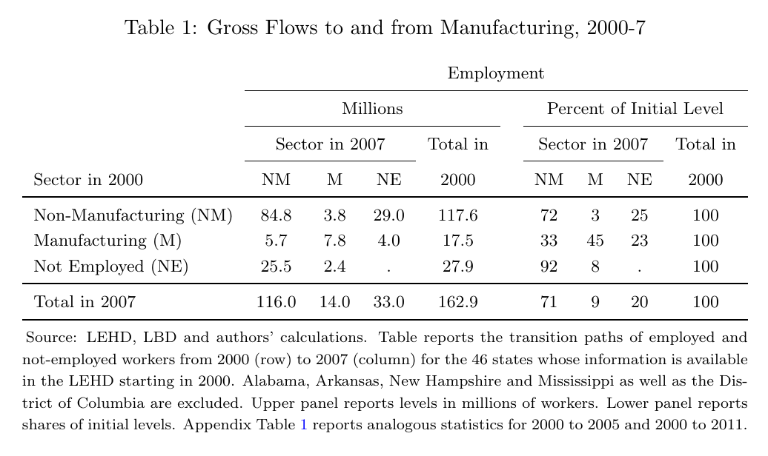

Slide 23
Gross Flows out of M, 2000g2007 45% stay in M, 23%gNE

Slide 24
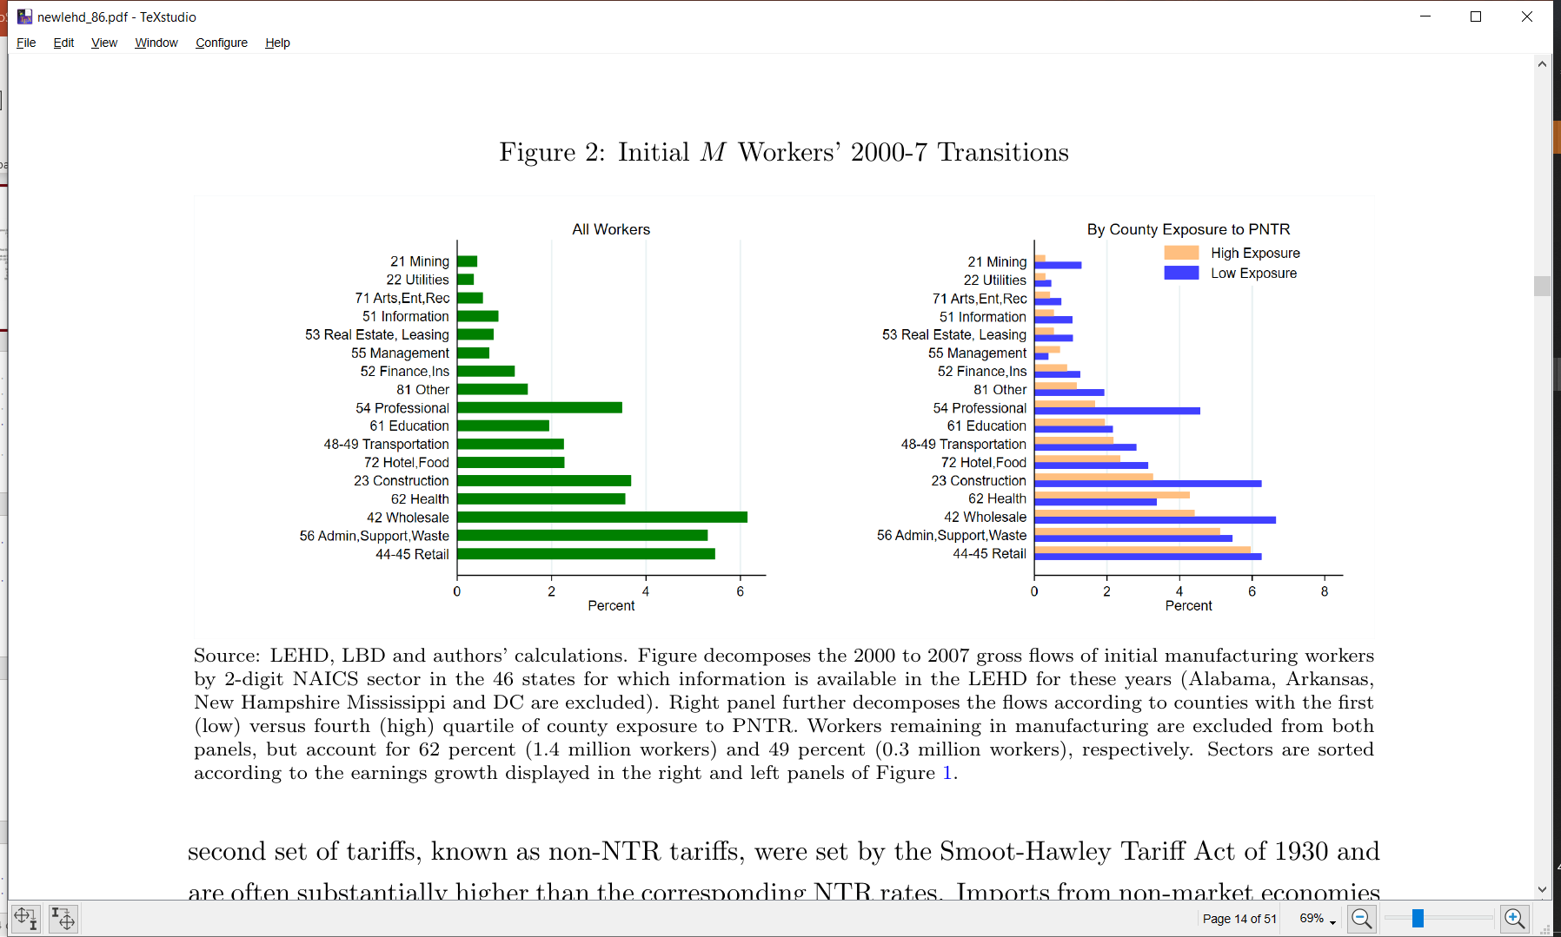
Gross Flows out of M, 2000g2007 45% stay in M, 23%gNE
Change of industry but not occupation, or
structural change?
Charles et al. (2015)
Outsourcing to temp agencies?

Slide 25
Gross Flows out of M, 2000g2007

Slide 26
Gross Flows out of M, 2000g2007
Moves to professional, wholesale and construction are more likely in LESS exposed areas
Move to health more likely in MORE exposed areas

Slide 27
Median ΔEarnings, 2000g2007

Slide 28
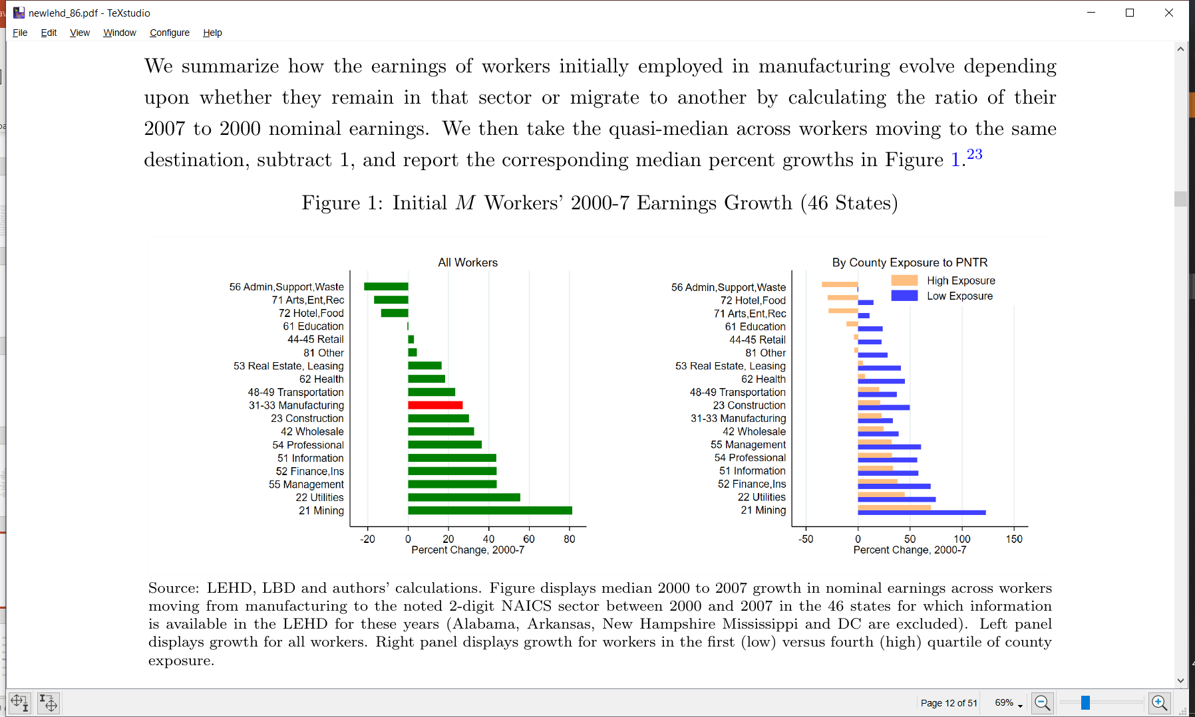
Median ΔEarnings, 2000g2007
Median earnings growth among those staying in M is ~3% per year
Median earnings growth universally lower with exposure

Slide 29
Outline
Introduction
Data
Reallocation after PNTR
PNTR and earnings: direct specification
PNTR and earnings: IO specification
Conclusion

Slide 30
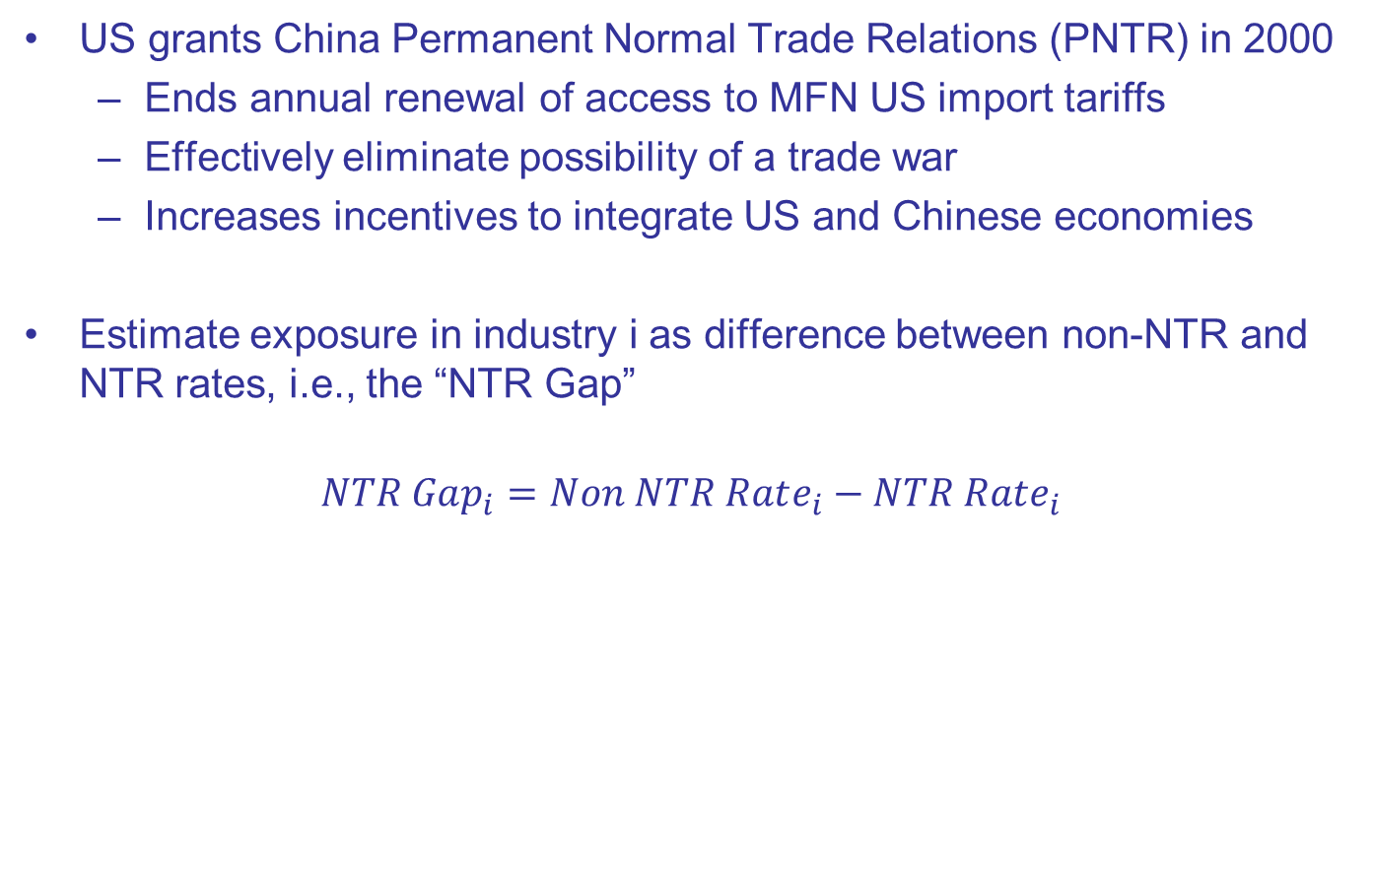
PNTR
US grants China Permanent Normal Trade Relations (PNTR) in 2000
Ends annual renewal of access to MFN US import tariffs
Effectively eliminate possibility of a trade war
Increases incentives to integrate US and Chinese economies
Estimate exposure in industry i as difference between non-NTR and NTR rates, i.e., the “NTR Gap”
$$NTR Gap_{i}=Non NTR Rate_{i}−NTR Rate_{i}$$
Notes:
Industry exposure captures industry switching costs
County exposure captures spatial moving costs

Slide 31
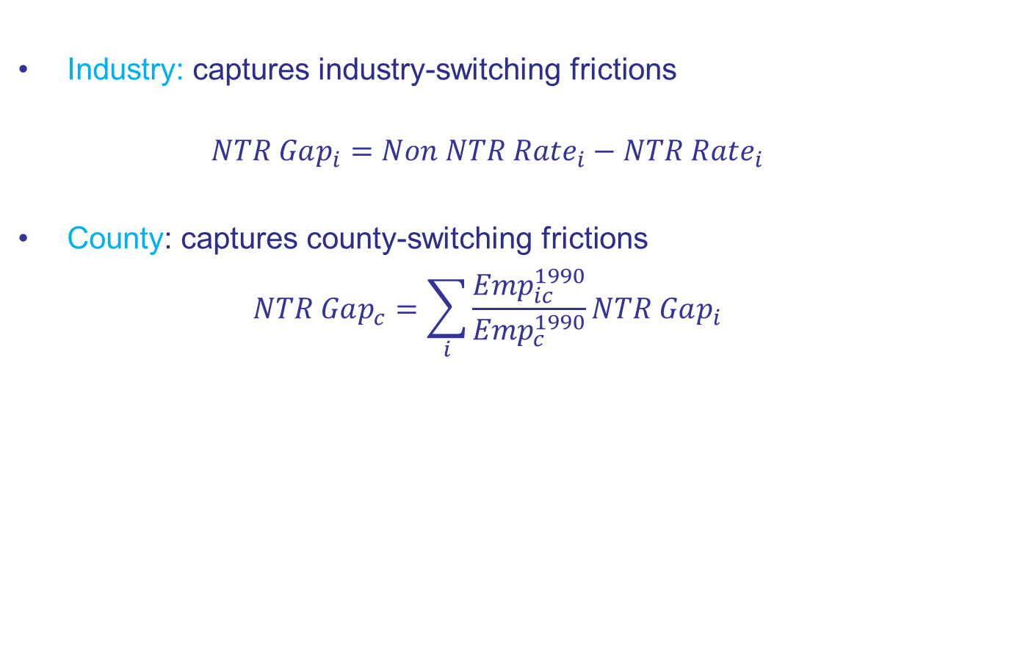
Two Dimensions of Exposure
Industry: captures industry-switching frictions
$$NTR Gap_{i}=Non NTR Rate_{i}−NTR Rate_{i}$$
County: captures county-switching frictions
$$NTR Gap_{c}=\sum_{i}{\frac{Emp_{ic}^{1990}}{Emp_{c}^{1990}}NTR Gap_{i}}$$
Notes:
Industry exposure captures industry switching costs
County exposure captures spatial moving costs

Slide 32
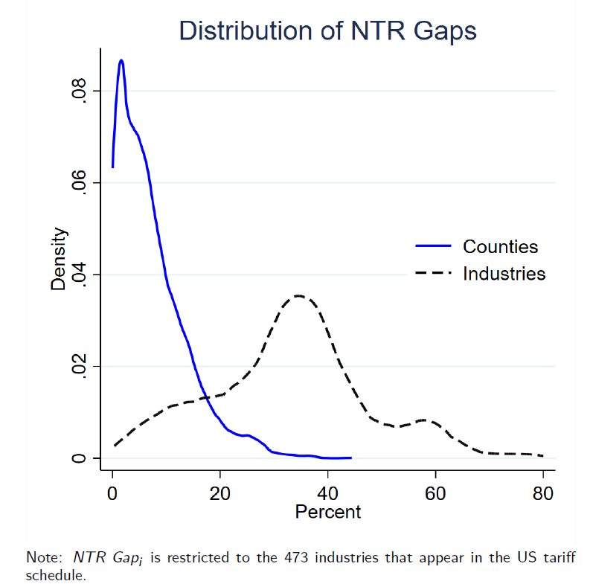
(All)
(M Only)
Notes:
75-25 interuartiles is around 20

Slide 33
Regression Samples
Data for 19 states are available from 1993-2014
Construct 5% random stratified sample on non-retirees (<64 in 2014)
>1M workers
>200K firms
20% of worker are initially at M firms; 80% at initial NM firms
High-tenure (HT) regression sample
Employed by same firm between 1993 to 1999
Low-tenure (LT) regression sample
Employed (earnings>0) 1993 to 1999

Slide 34
Regression Sample Attributes
Worker Attributes, by Sample
High Tenure
Low Tenure
M workers are less likely to be female and more likely to be American born and less educated that initial NM workers

Slide 35
Regression Sample Attributes
Worker Attributes, by Sample
High Tenure
Low Tenure
M workers are less likely to be female and more likely to be American born and less educated that initial NM workers
High Tenure workers are 2-3 years older and have substantially higher initial earnings, but otherwise look similar

Slide 36
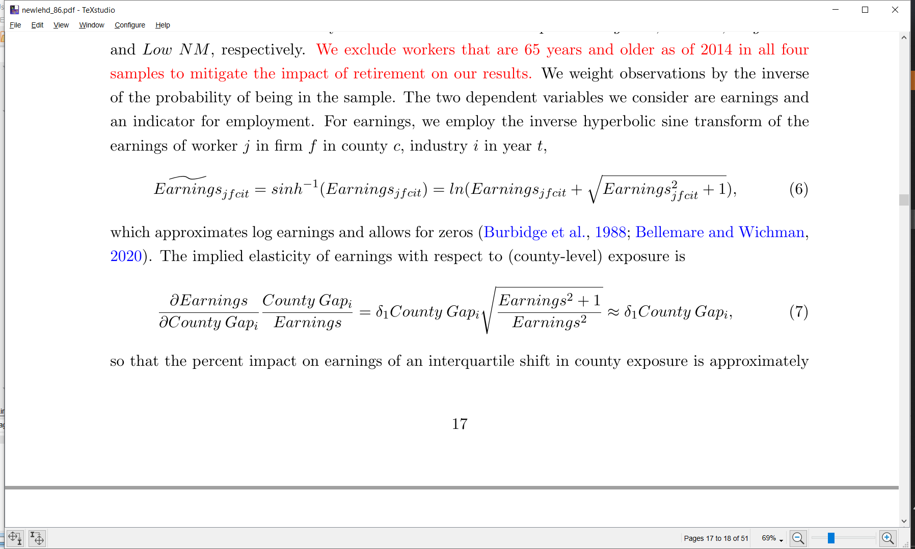
Outcomes
Earnings
Use arcsin transform to allow for zeros
Employment
Use dummy variable indicating worker has paid employment

Slide 37
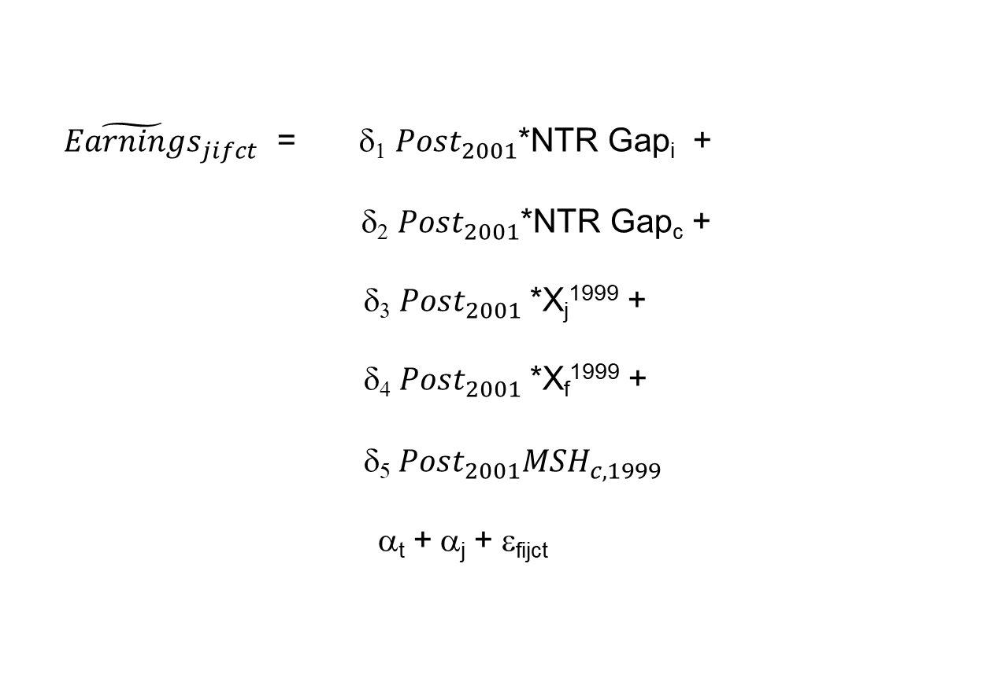
“Direct” Specification (1993-2014) j=individual; f=firm; i=industry; c=county; t=year
${\tilde{Earnings}}_{jifct}$ = δ₁ $Post_{2001}$*NTR Gap_{i} + δ₂ $Post_{2001}$*NTR Gap_{c} + δ₃ $Post_{2001}$*X_{j}¹⁹⁹⁹ +
δ₄ $Post_{2001}$*X_{f}¹⁹⁹⁹ +
δ₅ $Post_{2001}MSH_{c,1999}$
α_{t} + α_{j} + ε_{fijct}
Exposure via initial industry of employment
Exposure via initial county of employment
Initial worker attributes (gender, race, education, age)
Initial firm attributes
(firm’s size, age and multi-unit status)
County c's 1999 manufacturing share
Year and worker FE
Notes:
MSH This term is a separate control for the prevalence of manufacturing in a county, thereby allowing the county exposure
term to reect exposure to PNTR conditional on the county's manufacturing share

Slide 38
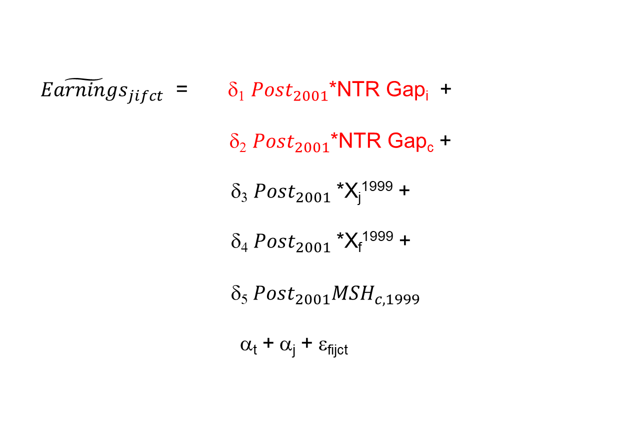
“Direct” Specification (1993-2014) j=individual; f=firm; i=industry; c=county; t=year
${\tilde{Earnings}}_{jifct}$ = δ₁ $Post_{2001}$*NTR Gap_{i} + δ₂ $Post_{2001}$*NTR Gap_{c} + δ₃ $Post_{2001}$*X_{j}¹⁹⁹⁹ +
δ₄ $Post_{2001}$*X_{f}¹⁹⁹⁹ +
δ₅ $Post_{2001}MSH_{c,1999}$
α_{t} + α_{j} + ε_{fijct}
Exposure via initial industry of employment
Exposure via initial county of employment
Initial worker attributes (gender, race, education, age)
Initial firm attributes
(firm’s size, age and multi-unit status)
County c's 1999 manufacturing share
Year and worker FE
Notes:
MSH This term is a separate control for the prevalence of manufacturing in a county, thereby allowing the county exposure
term to reect exposure to PNTR conditional on the county's manufacturing share

Slide 39
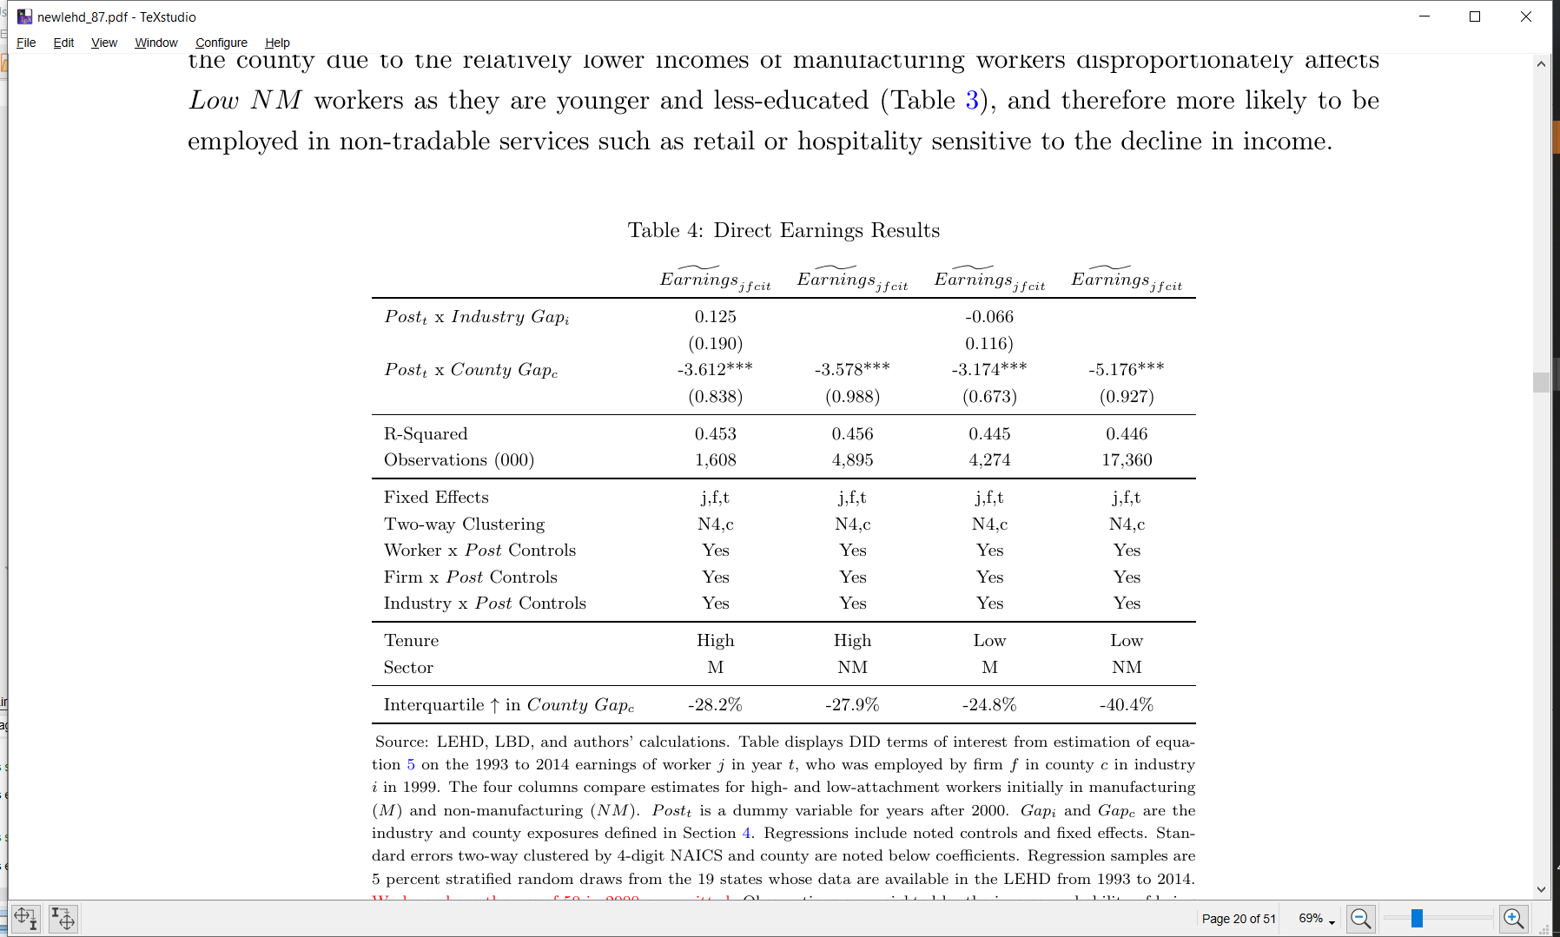
“Direct” Earnings Specification 1993-2014
No impact of industry exposure
County exposure significant for both M and NM
Similar impact for M and NM

Slide 40
“Direct” Earnings Specification 1993-2014
M: High tenure do worse
NM: Low tenure do substantially worse

Slide 41
“Direct” Earnings Specification County Exposure DID Coefficient

Slide 42
Outline
Introduction
Data
Reallocation after PNTR
PNTR and earnings: direct specification
PNTR and earnings: IO specification
Conclusion

Slide 43
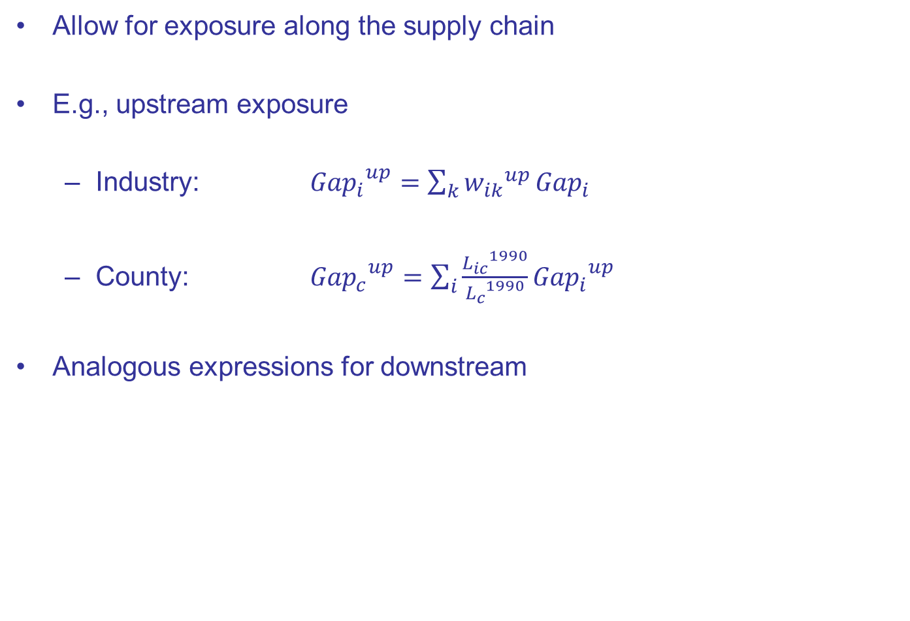
IO Specification
Allow for exposure along the supply chain
E.g., upstream exposure
Industry: ${{Gap}_{i}}^{up}=\sum_{k}{{w_{ik}}^{up}}{Gap}_{i}$
County: ${{Gap}_{c}}^{up}=\sum_{i}{\frac{{L_{ic}}^{1990}}{{L_{c}}^{1990}}}{{Gap}_{i}}^{up}$
Analogous expressions for downstream
IO-coefficient (w) weighted average of all industries k that industry I buys from
Labor-weighted average upstream gap of all industries county c produces

Slide 44
Up- and Downstream Industry Exposure Manufacturing Highlighted, Medians Noted with Dashed Lines
Hospitals
Textiles
R&D

Slide 45
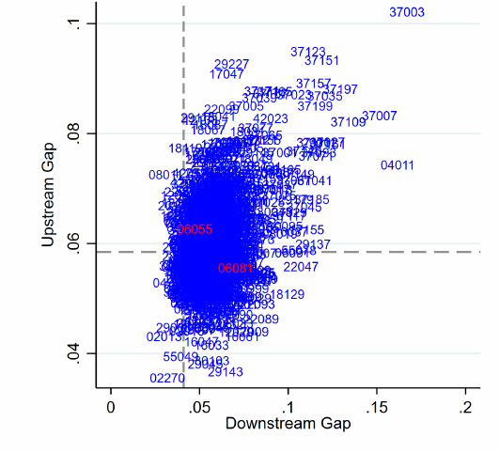
Up- and Downstream County Exposure Medians Noted with Dashed Lines
Napa
High Gap^{UP} (Health, Hotels, Retail, Wine)
Low Gap^{DN} (mostly consumers)
San Mateo
Low Gap^{UP} (Software, Chem, Comp)
High Gap^{DN} (Electronics)

Slide 46
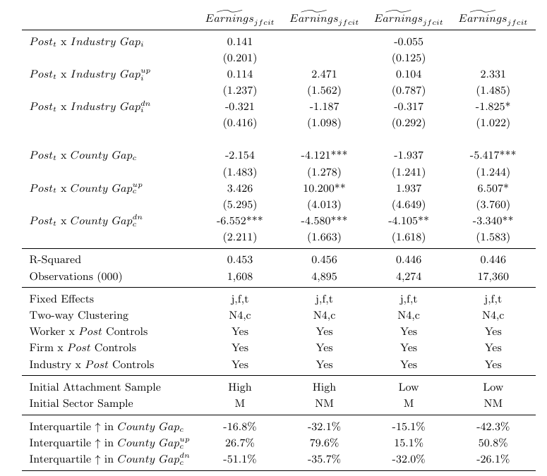
“IO” Specification 1993-2014
No impact of industry exposure
County signs as expected
Large, positive impact of upstream exposure is particularly important for NM workers

Slide 47
“IO” Specification 1993-2014
Similar pattern for low-tenure workers

Slide 48
“IO” Specification 1993-2014
What’s the best way to assess economic significance here?

Slide 49
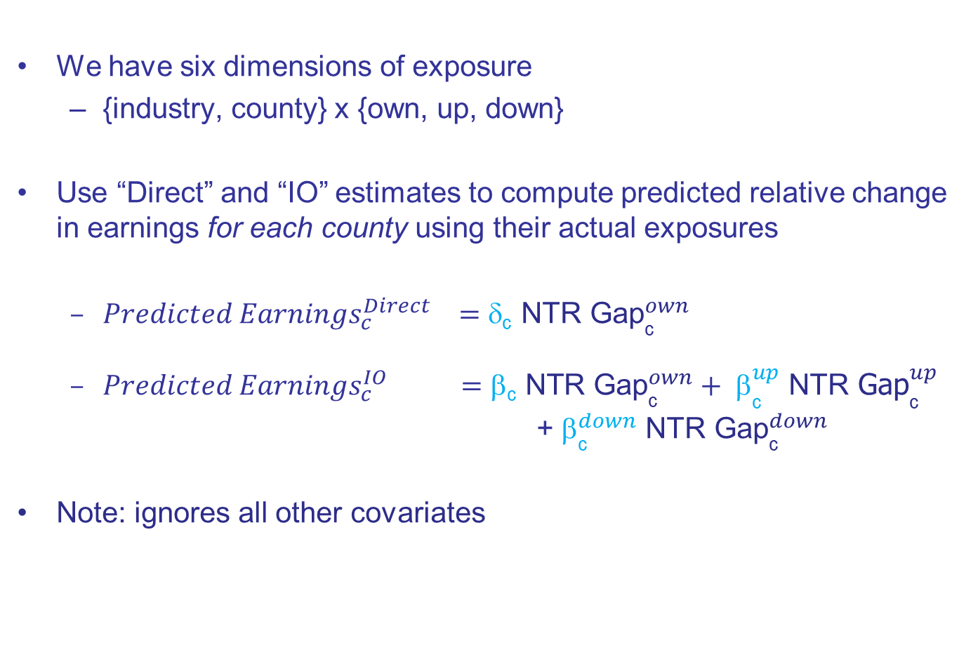
Use Predictions for Economic Significance
We have six dimensions of exposure
{industry, county} x {own, up, down}
Use “Direct” and “IO” estimates to compute predicted relative change in earnings for each county using their actual exposures
${Predicted Earnings}_{c}^{Direct} =\text{d}\text{c}{ \text{NTR} \text{Gap}}_{\text{c}}^{own}$
${Predicted Earnings}_{c}^{IO} =\text{b}\text{c} \text{NTR}{ \text{Gap}}_{\text{c}}^{own}+ {\text{b}}_{\text{c}}^{up} \text{NTR}{ \text{Gap}}_{\text{c}}^{up}$
+ ${\text{b}}_{\text{c}}^{down} \text{NTR}{ \text{Gap}}_{\text{c}}^{down}$
Note: ignores all other covariates

Slide 50
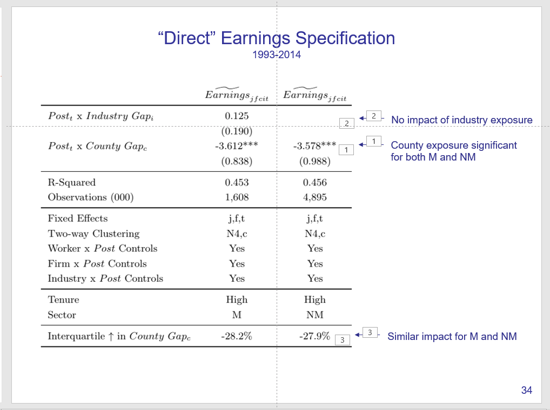
Direct vs IO Specification ΔEarnings Predictions

Slide 51
Direct vs IO Specification ΔEarnings Predictions
IO specification prediction switches from negative to positive for small number of counties

Slide 52
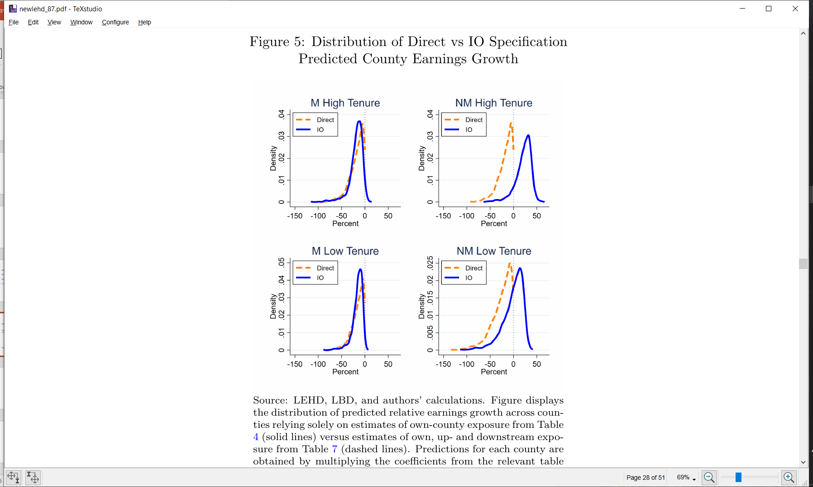
Direct vs IO Specification ΔEarnings Predictions By Sample

Slide 53
Direct vs IO Specification ΔEarnings Predictions By Sample

Slide 54
Direct vs IO Specification ΔEarnings Predictions By Sample
IO specification prediction switches from negative to positive for 90% of counties
IO specification prediction switches from negative to positive for 58% of counties

Slide 55
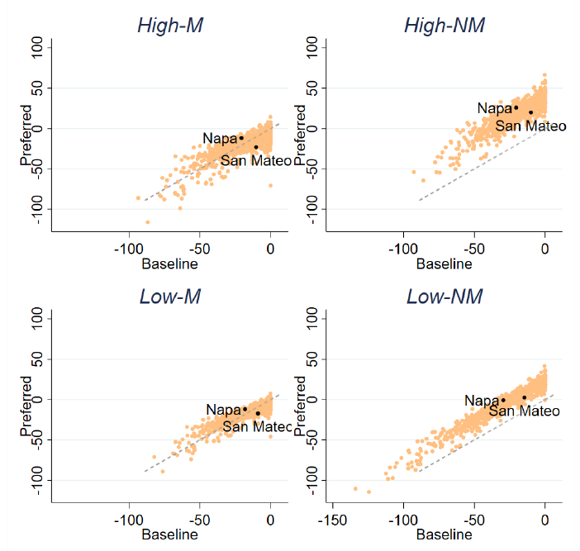
Distribution of Predicted Change in Relative County Earnings Direct vs IO Predictions, by Sample
Napa
-21 to -12
San Mateo
-10 to -23
Napa
-20 to 26
San Mateo
-20 to 10
Napa
-21 to -12
San Mateo
-10 to -23
Napa
-20 to 26
San Mateo
-20 to 10
IO
IO
IO
IO
Direct
Direct
Direct
Direct
Napa
-18 to -12
San Mateo
-9 to -17
Napa
-30 to 0
San Mateo
-14 to 3
Napa
-18 to -12
San Mateo
-9 to -17
Napa
-30 to 0
San Mateo
-14 to 3
IO
IO
IO
IO
55
Direct
Direct
Direct
Direct

Slide 56
Distribution of Predicted Change in Relative County Earnings Direct vs IO Predictions, by Sample
Napa
-21 to -12
San Mateo
-10 to -23
Napa
-20 to 26
San Mateo
-20 to 10
IO
IO
Direct
Direct
Napa
-18 to -12
San Mateo
-9 to -17
Napa
-30 to 0
San Mateo
-14 to 3
IO
IO
Direct
Direct

Slide 57
Conclusions So Far
County exposure matters more than industry exposure
Upstream exposure mitigates own and downstream exposure
Exposed M workers exhibit substantial losses in relative earnings
NM workers with upstream exposure exhibit relative gains

Slide 58
Thanks!

